Slide 1
Assisting a client in choosing a strategic area to setup a new Coffee Shop in West Toronto
Toronto is a city which reveals itself over time. It grows on people until they suddenly realize that there is nowhere else in the world they would rather be.
There are many cultures, cuisines and the city just produces better restaurants. The city is incredibly foot friendly whether you are just going for a gentle walk or attending nice local venues in the area.
Setting up a new Coffee Shop in a strategic location will depend on numerous factors which contribute to a location being “strategic”.

Slide 2
Problem The problem that we are trying to address is finding a strategic area to setup a new Coffee Shop in West Toronto. As you can imagine, we would need to assess all the available neighbour hoods in the area and better understand the trending venues in relevant areas before we can attempt to make a good recommendation based on consumed valuable factors.

Slide 3
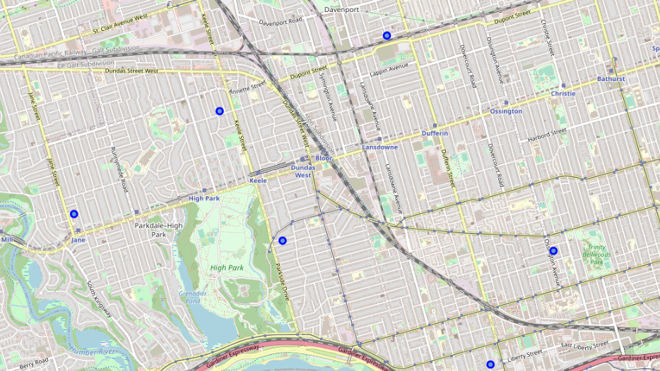
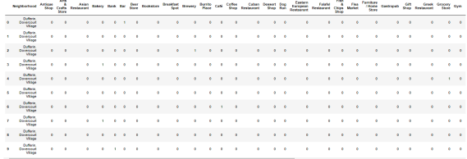
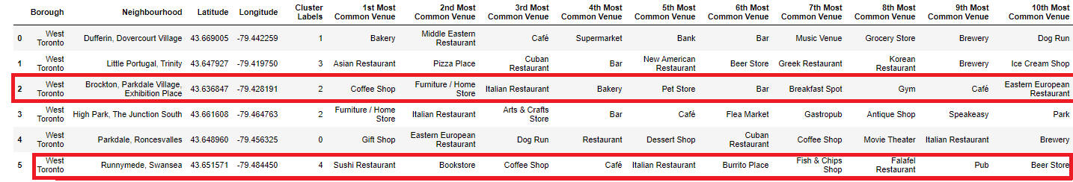
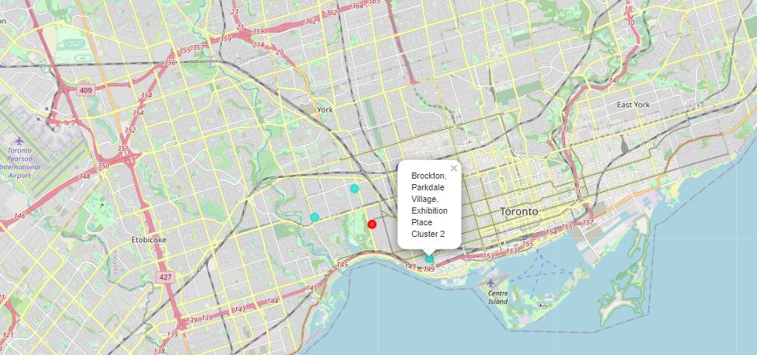
Approach to solve the problem
Finding Data.
Performing data cleaning and structuring.
Analysing Data.
Visualising Data.
Comparing venues data within 1km.
Identifying trending Coffee Shop venue being within top 3 spots.
Using K-mean to cluster the venues in the neighbour hood.

Slide 4
Conclusion
It is safer to start up a new Coffee Shop in a location where such venue is already trending.
We could have taken the approach of looking at venues where Coffee Shop is non-existent and break into that market however the safest option was to leverage neighbourhoods where such venue is a hot spot.
Additionally, we hedged further risks by observing the nearby venues for both Coffee spots where we can see that each is surrounded by attractive venues such as amazing restaurants and Bakery. This is also factored into the equation as it will bring more traffic to the Coffee Shop.
.

